Slide 1

Google Data Analytics CAPSTONE Case Study 1 - Cyclistic Bike-Share Ralph Jankowich November 28th, 2022

Slide 2
Cyclistic Bike-share Marketing Analysis GOALS
Annual memberships are more profitable for Cyclistic Bike-Share than casual riders. The goal of this analysis is to determine how to create a marketing campaign that will convince casual riders to buy annual memberships.

Slide 3
Cyclistic Bike-share Data sources
Data is from the 12 most recent months of trip data from Motivate International Inc. under the license here.
Data includes information from all bike rides including:
Starting and ending dates and times
Starting and ending latitudes and longitudes
Starting and ending station names and id, if applicable.
Membership type for each ride
Bike type used for each ride

Slide 4

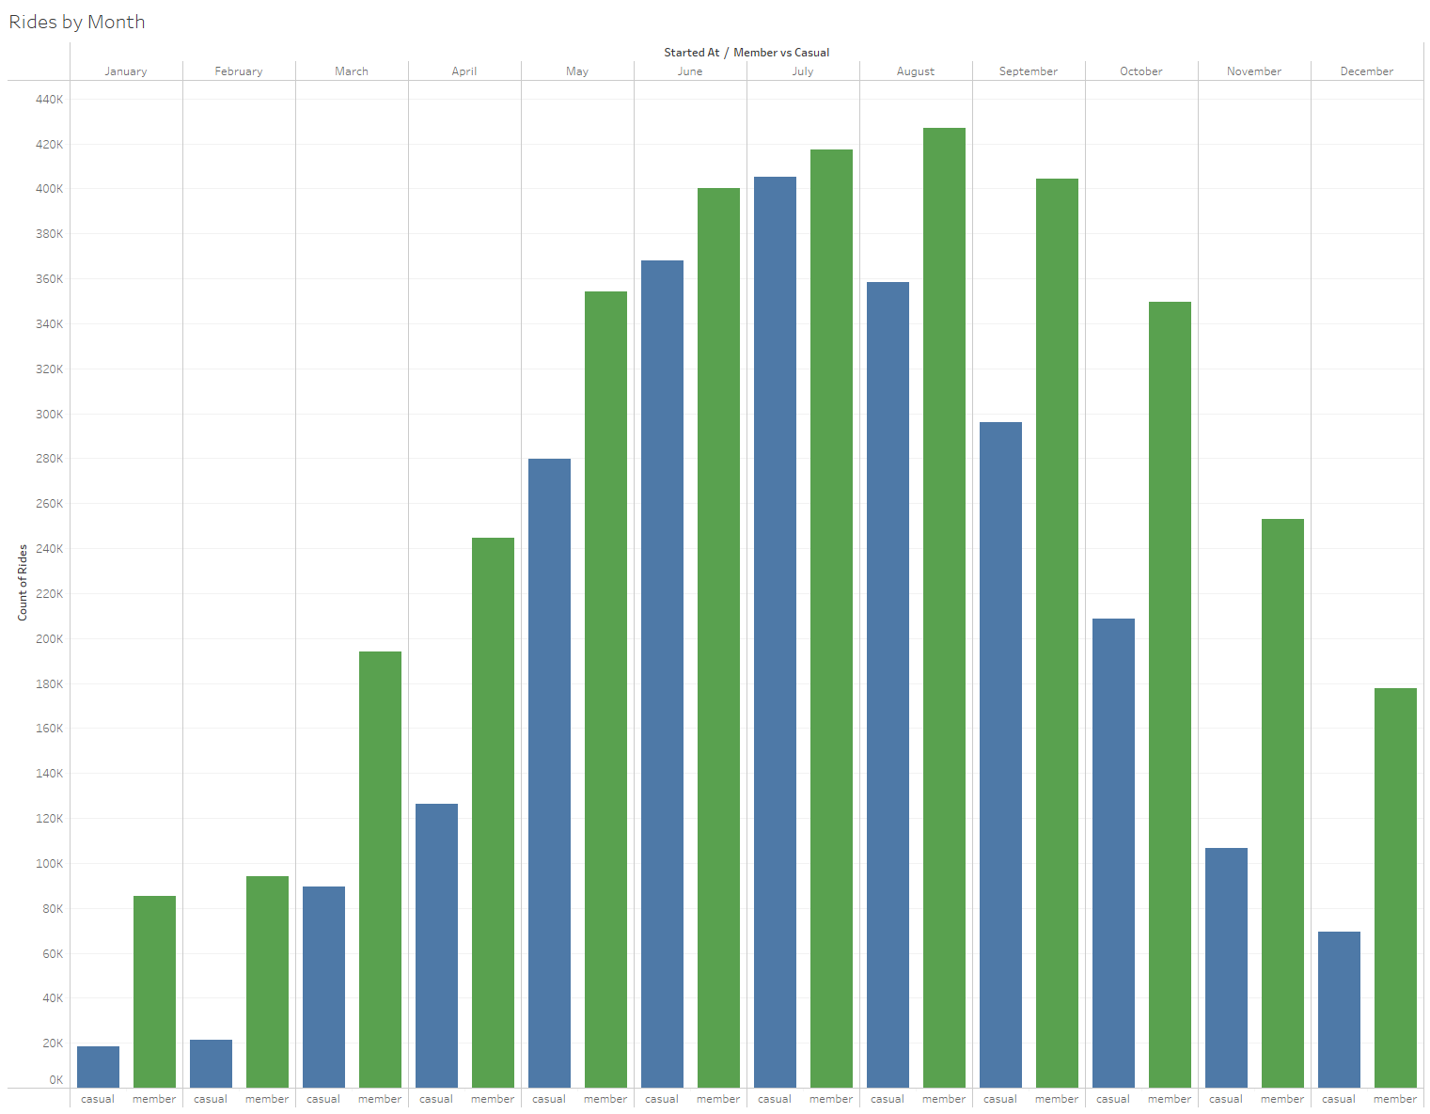
Casual Rides and Member Rides by Month
May is the month when casual ridership jumps. Members start riding a lot more in March. Advertising targeting casual riders should start in May when the casual riders look forward to riding more in the coming months.
Notes:
It’s no surprise that fewer bike rentals happen in the colder months.

Slide 5
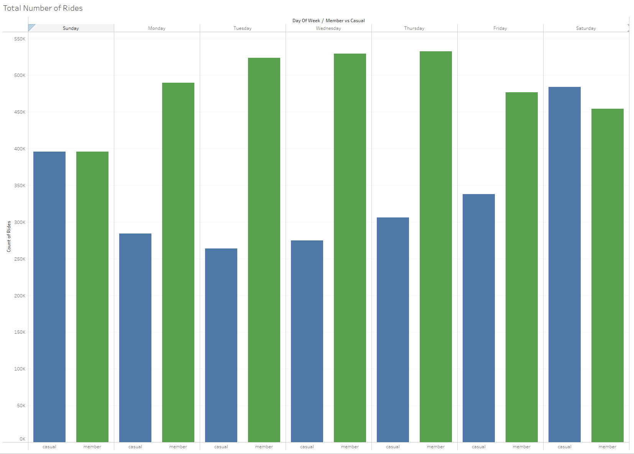
Ride Counts by Day of the Week
Casual riders use Cyclistic bikes as often as members on the weekend, but members are more likely to ride during the weekdays. This suggests members are more likely to use cyclistic to commute to work.

Slide 6
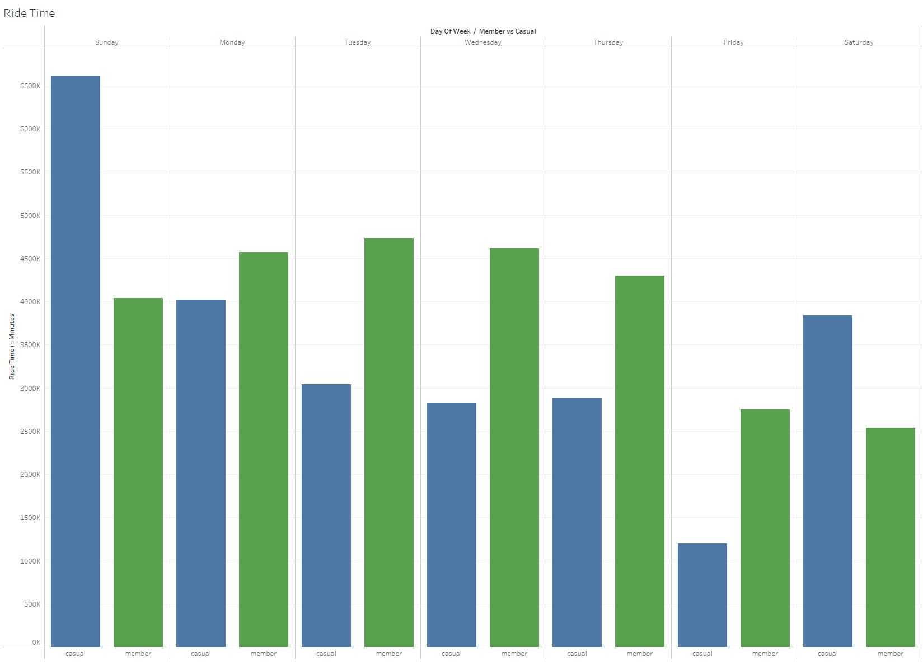
Ride Time of Casual Riders and Members
Casual riders spend more time renting cyclistic bikes on weekends compared to members. Since the number of rentals was roughly even between the two groups, we can say the casual riders tend to get more value out of each rental on the weekends.

Slide 7
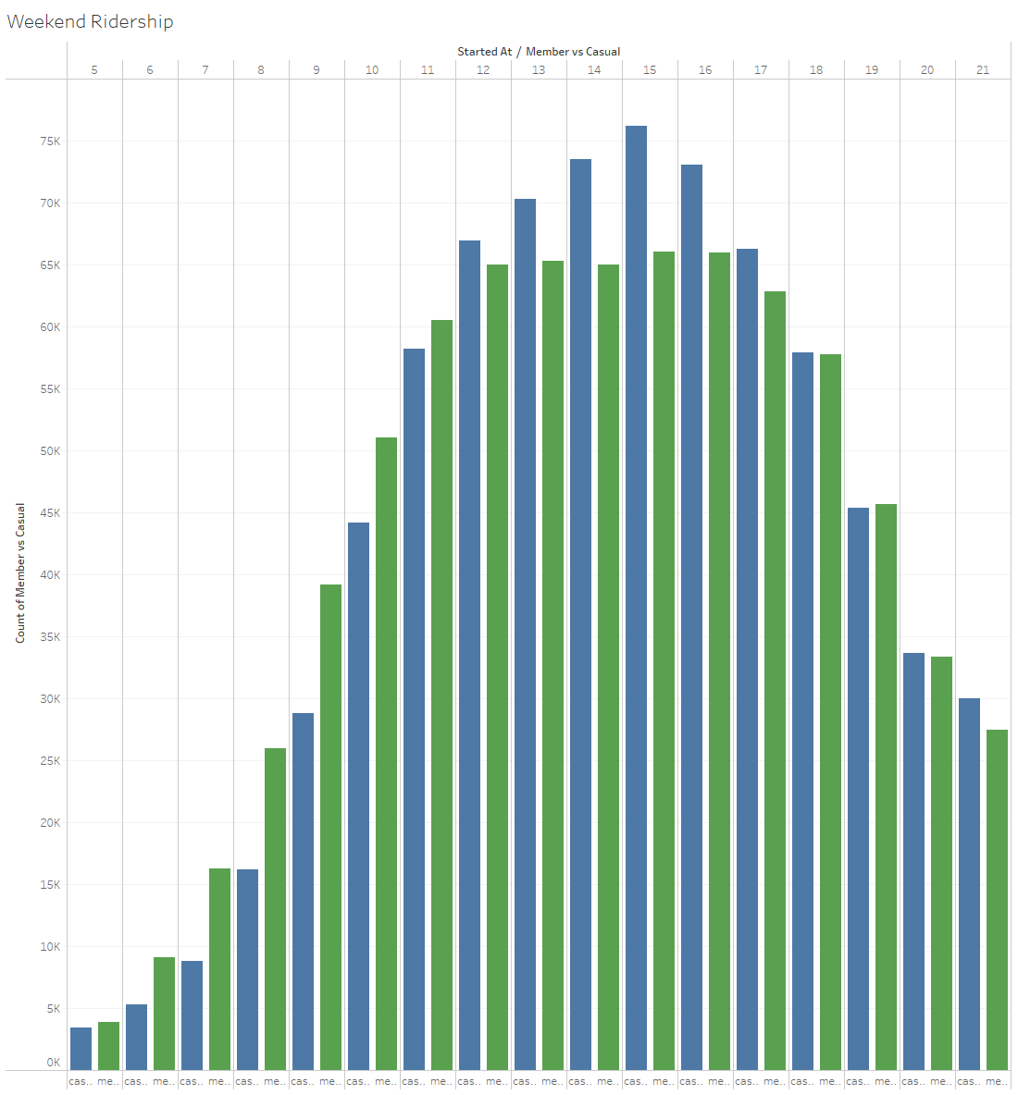
Ridership by Starting Hour on Weekends
We see no difference between members and casual riders on weekends in terms of when they start their rides, but note that most casual riders ride between 10am and 7pm on weekends.

Slide 8
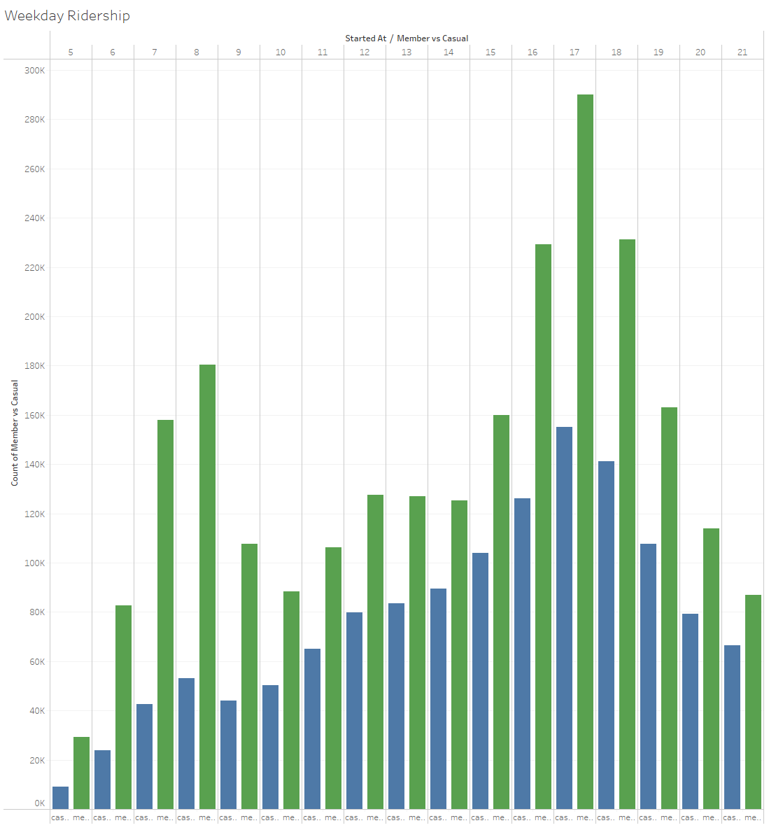
Ridership by Starting Hour on Weekdays
This data shows that a lot of members ride during the morning and evening rush hours. Using Cyclistic bikes to commute should be a key component of our advertising strategy as we try to convert casual riders to member.

Slide 9

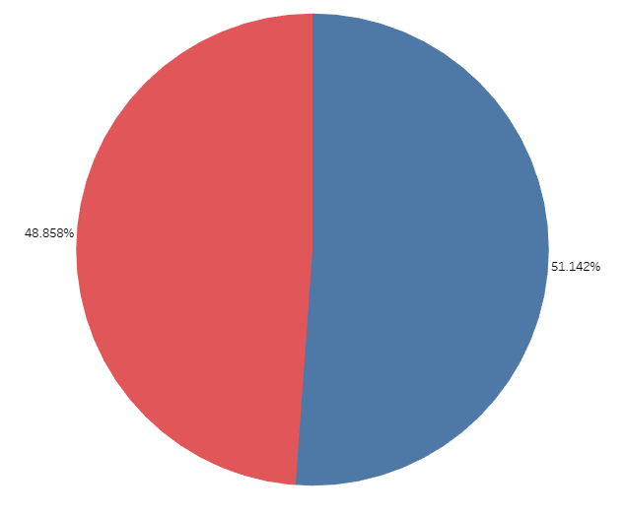
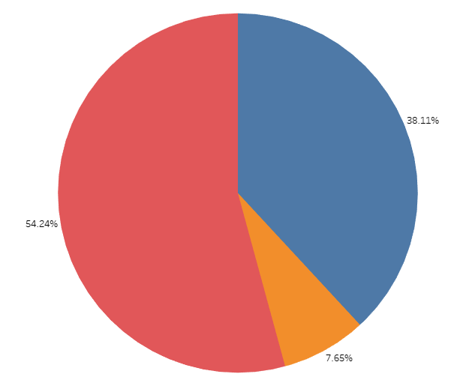
Bike Type Choice Comparison
Members are split evenly between classic bikes and electric bikes. Casual riders have a slightly higher preference for electric bikes which indicates a preference for transportation over exercise.
Member Casual

Slide 10
Cyclistic Bike-share Summary of Observations
The main difference between members and casual riders is members use Cyclistic a lot more to commute to and from work.
Casual riders on the weekends see high value in Cyclistic bike rentals.
May is the best month to start advertising to casual riders, and the mornings on weekends are the best time to advertise to casual riders.
Casual riders have a greater preference for electric bikes.

Slide 11
Cyclistic Bike-share Action ITEMS
Highlight the value and of bike shares for commuting to work.
Target advertising during the weekends when casual riders are enjoying the bike share.
Run the advertising campaign in the spring when casual riders are staring to use the bikes in large numbers.
Highlight the availability of electric bikes in the campaign.

Slide 12
Appendix
The details on how this analysis was done. Data was cleaned and transformed in SQL using Google’s BigQuery platform. All visualizations were created in Tableau.

Slide 13
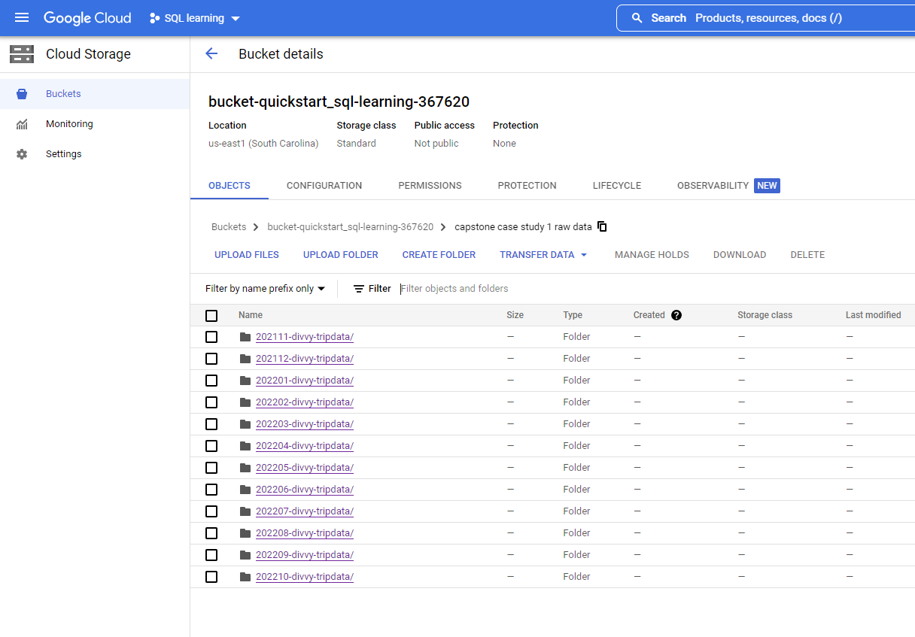
Data Management
BigQuery sandbox account didn’t allow enough storage to upload all the Cyclistic data, so I signed up for the trial Google Cloud account and uploaded 12 months of data into a private bucket for import into BigQuery.
Data licensing:
Divvy license agreement

Slide 14
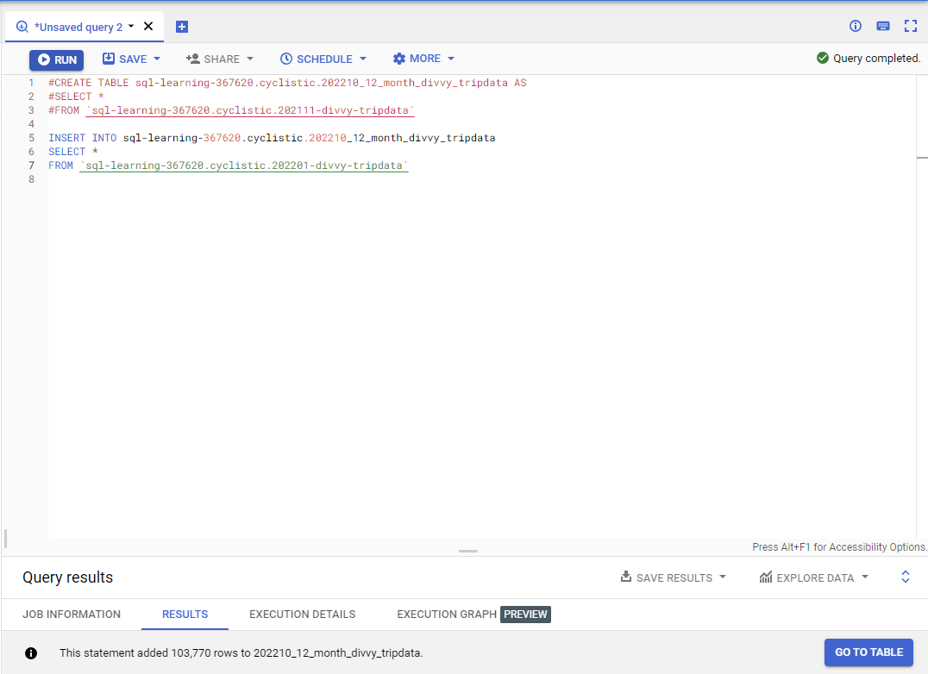
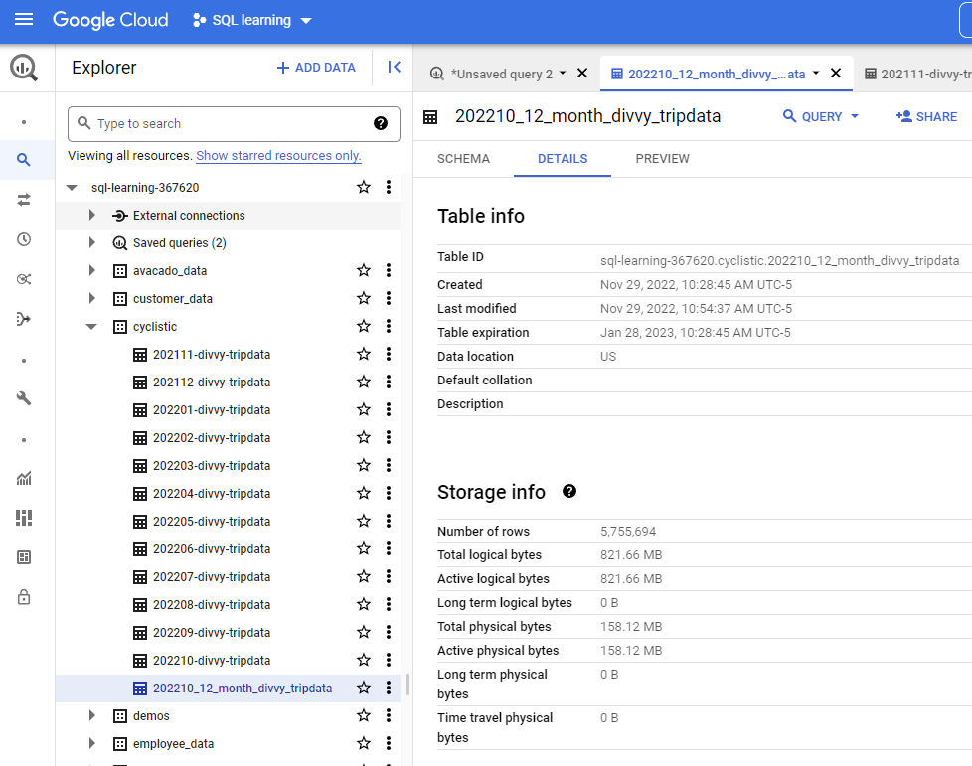
Combined DATA in SQL using Bigquery
Created tables for each of the last 12 months of tripdata and combined them into one table using SQL CREATE TABLE and INSERT INTO commands.

Slide 15
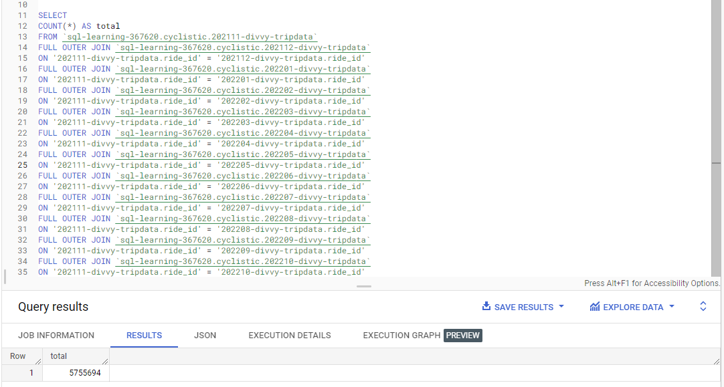
Verify Combined DATA in SQL
Verified that my combined table didn’t lose any data by verifying the total line count from the monthly tables matched the line count from the 12 month table. I also verified all the attributes were same for the monthly and combined tables.

Slide 16
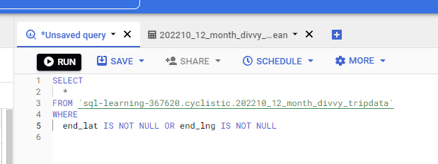
Cleaning DATA in SQL
Some trip data is missing end_lat or end_lng values so those are filtered out. These could have been malfunctioning or damaged bikes.

Slide 17
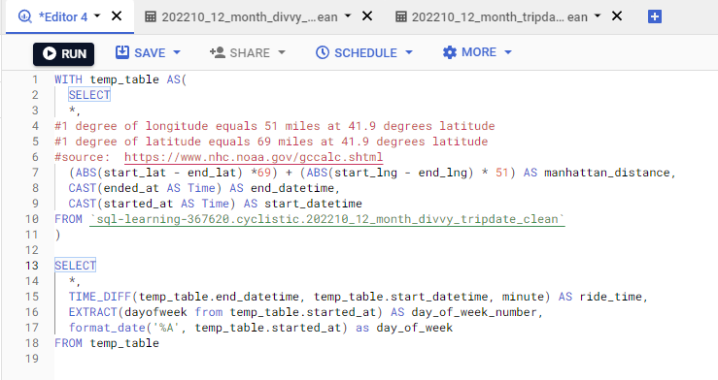
Transform DATA in SQL
Added a columns for Manhattan distance in miles, along with ride_time and day of the week. I saved this as a table in BigQuery for further analysis. This wound up not panning out, but was good SQL practice.

